Slide 1

MENTOR INTRODUCTION
Located in Chennai - hometown
Currently INNOVATION HEAD, INDIA REGION for STELLANTIS: 4th largest AUTO OEM globally and is a recent merger of FCA (FIAT CHRYSLER AUTOMOBILES) & PSA (PEUGEOT)
It is a leadership role include leading AI/ML Projects covering Autonomous Vehicles/ADAS, Predictive Maintenance, Driver/ Occupant monitoring, Digital Twins etc
~27 years of Industry Work Experience (~11 years in the US and rest in India) esp. in Automotive R&D including Advanced Vehicle Engineering, Virtual Simulation & Analytics for System & Vehicle performance.
Wide range of company work experience including Auto OEM – FCA, DaimlerChrysler, Consultant to Toyota, Renault-Nissan, Consultant at TCS, Start-up – Neilsoft Inc.
Currently Senior Mentor/ Teacher for Adv. Technologies/ Innovation methods at work, Tech expert in AI/ML, NV and Acoustics, Internationally Certified Yoga teacher (recreational) etc
Education:
B.Tech, Mechanical Engineering, IIT Madras, India
M.S, Mechanical Engineering, Clemson University, SC, USA
PGP- AIML, Great Lakes Executive Learning and Univ. Texas at Austin (McCombs School of Business)
Hobbies: Yoga, Sound Engineering (Music \Studio)
MURALI BALASUBRAMANIAN
INNOVATION HEAD, INDIA REGION
STELLANTIS
INDIA- ASIA PACIFIC REGION

Slide 2
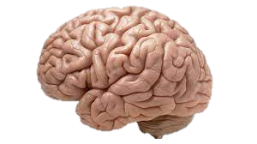


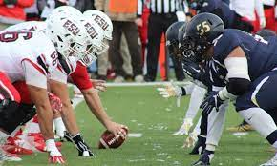
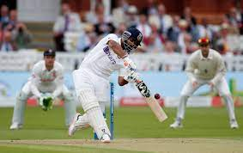
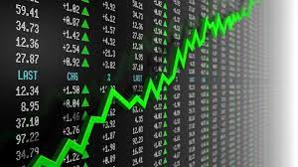
THE HUMAN WORLD!
We Observe
What’s Important?
We Understand
We Analyze
We Predict
The World
(We Sense)
Smart decisions
We Act!

Slide 3

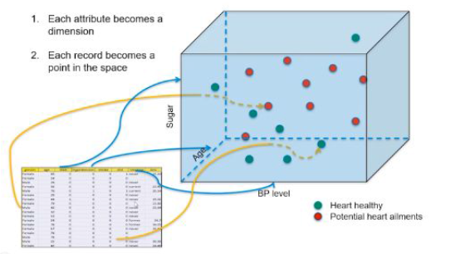
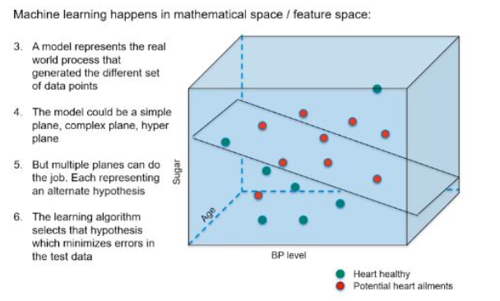
THE AI/ML LANDSCAPE
Decision
Science
Machine Learning
World
(Data
Source)
Machine
Learning Model
Actionable inputs
Data
Learn
Associations
Trends
Cycles
Patterns
…
Predictions
Observe & Record
(DAQ & Collation)
Datasets
Mathematical
structures
Smart decisions
Data Science
Multi-dimensional (attributes) → data point

Slide 4

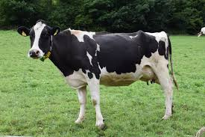
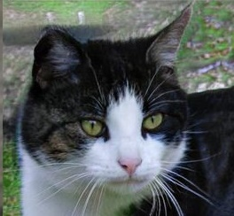

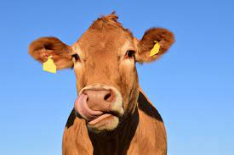



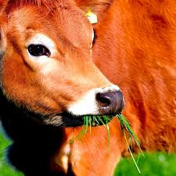

…..
-- -- --
Output
(Labels)
-- -- --
Cat
Cow
Cat
A Machine Learning Illustration
New Image input
Cow
Cat
Dog
Machine Learning Model
(“Learns” the relationships
And enables predictions)
Predict
Output
for new
Inputs
Dog
Cow
Dog
? Label
-- -- --
-- -- --
…..
Input – Images
(nxnx3 pixel data)

Slide 5
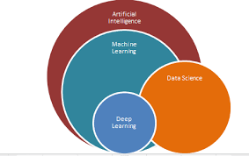
AI vs ML vs Data Science
Relates to Machine systems
that emulate “human thinking”
Relates to Machines programmed (ML models) to “learn” via Statistical techniques, Algorithms to draw insights from vast historical and real time Data to answer specific questions that lead to decisions and actionable tasks
Relates to recording, storing, handling, Analyzing, Visualizing all sorts of data for downstream use

Slide 6
Python Basics – Key Libraries: NumPy and Pandas

Slide 7
Learning Objectives
Installation Steps
Data Types in Python
Numpy
Pandas
Case Study
7

Slide 8
Python ( What and Why ?)
Python is the most popular programming language & choice for Data Scientists / Data Engineers across the world
A very structured, object-oriented and functional programming language
Very rich libraries & functions enabling modular programming
Excellent & very large community support
Easy to deploy in production
Most new state of the art technologies (such as based on deep learning) are based on Python libraries and have excellent support to further refine/proliferate
8

Slide 9
Installation Steps
Install using the instruction given in the below links - 1. Install Jupyter - http://jupyter.org/install Preferred installation method is through Anaconda distribution.
Install Python 3.8 version. 2. Anaconda 5.2 For Linux Installer - https://www.anaconda.com/download/#linux 3. Anaconda 5.2 For macOS Installer - https://www.anaconda.com/download/#macos 4. Anaconda 5.2 For Windows Installer - https://www.anaconda.com/download/#windows (You need to download the version compatible with your OS)
Other Key Links to subscribe:
https://www.kaggle.com/datasets
https://github.com/
https://stackoverflow.com/users/signup
9

Slide 10
Installation with Python 3.6
Download Anaconda latest version Individual edition (Python 3.8 or higher)
For windows – open command prompt by typing “Anaconda prompt” in search next to windows icon
Type following commands (create & activate new environment with python 3.6 – you have the option to switching environments to 3.8 if you need easily – so this is best)
conda --version
conda create --name pyth36 python=3.6
conda activate pyth36

Slide 11
Common Python libraries
NumPy – handling multi-dimensional arrays
Scipy – Statistical package
Matplotlib, seaborn – Visualisation
Pandas – handling arrays & dataframes

Slide 12
Types of common variables
Integer
Float
String
Logical
[-2346543, -542, 0, 7643, 99999]
[-23.43, -14., 0., 2.3E+04, 999999.]
[“Dog”, “Murali”, “Abc123”, “Krishna_Hyd”]
[TRUE, FALSE, FALSE, TRUE, TRUE]

Slide 13
Data Types in Python
Apart from data types like int, string, float Python has the below data types which are very useful for data science -
List
Tuples
Dictionaries
Int
Str
List of Str
Logical/Boolean
Float
Str
List from a Bank Record → Custid = [[A/C#, ‘J’, [‘Rekha’, ‘Rohit’], TRUE, ‘yes’, Balance, ‘Address’, ….],
[A/C#, ‘S’, [‘Prakash’], FALSE,’no’, Balance, ‘Address’,…..]] → List of Lists
Tuple → (‘Chennai’, ‘LAT.’, ‘LONG.’, CITYSIZE, ‘South’) → Does not change and hence this can be a tuple for city spec.
Dictionary → daysofweek = {0:'Mon',1:'Tue',2:'Wed',3:'Thur',4:'Fri',5:'Sat',6:'Sun’} → Key and Value pairs
13

Slide 14
Python data structures - List vs Tuple vs Dictionary
Both list & tuples are ordered sequence of objects
Both can contain mixed data types
List is mutable while a tuple is like a list but immutable
Tuples are faster and consume less memory
Dictionary list of items in terms of a key and a value

Slide 15
Numpy
NumPy is the fundamental package for scientific computing with Python.
It contains -
A powerful N-dimensional array object - ndarray
Sophisticated (broadcasting) functions
check out general broadcasting rules @
https://numpy.org/doc/stable/user/basics.broadcasting.html
Useful linear algebra, Fourier transform, and random number capabilities etc.
Refer - http://www.numpy.org/
Advanced Math Function Library - https://docs.scipy.org/doc/numpy-1.13.0/reference/routines.math.html#trigonometric-functions

Slide 16
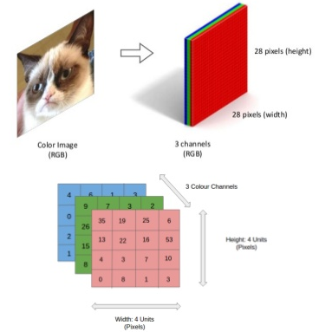
Numpy- N-d arrays, adv. Math functions
and operations
Color Images are represented
as 3D Tensors
Vector
[65. 80. 73. 56. 36. 77.]
Matrix
(1x6)
G H S SS E M
Functions
56. 72. 81. 55. 49. 68.
np.array, np.stack
np.random.randn
np.arrange, np.linspace
np.ones, np.zeros, np.eye
np.sin, np.log10, np.floor, ...
np.dot
np.load
np.save, np.savez
45. 67. 77. 66. 55. 71.
75. 81. 87. 69. 79. 91.
(28x28x3)
52. 61. 57. 49. 41. 68.
(4x6)
Tensor
Math operations: Linear Algebra, Fourier Transform etc

Slide 17
Pandas
A library written for the Python programming language for data manipulation and analysis.
In particular, it offers data structures and operations for manipulating numerical tables and dataframes.

Slide 18
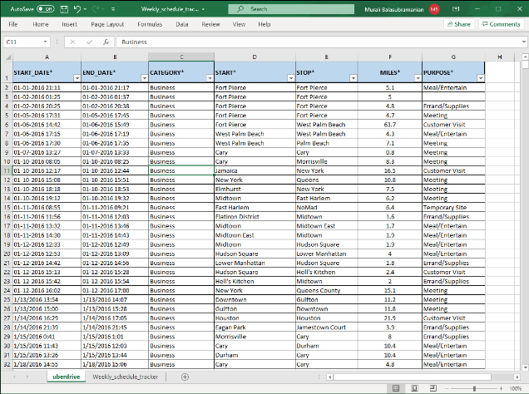
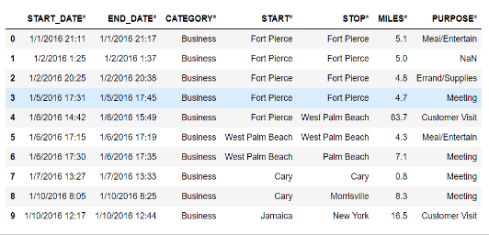

Pandas- Dataframe, Series, Panel
and data manipulation
df [‘?’]
Series: df [‘MILES’]
df
df.iloc(?)
Panel
(Workbook)

Slide 19
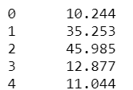
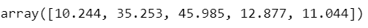
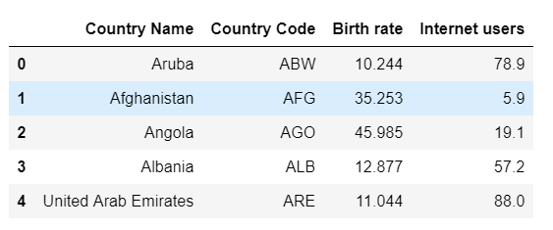
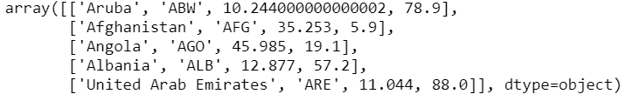
Practical example of the usage of dataframe, series & array on a dataset
Extract Birth rate as Pandas Series
Demographic data
Country Name | Birth rate | Internet users | Income Group
Aruba | 10.244 | 78.9 | High income
Afghanistan | 35.253 | 5.9 | Low income
Angola | 45.985 | 19.1 | Upper middle income
Albania | 12.877 | 57.2 | Upper middle income
United Arab Emirates | 11.044 | 88 | High income
pd [‘Birth Rate’]
pd.Birth Rate
Convert to dataframe
Extract birth rate as numpy array
df
Convert dataframe to numpy array

Slide 20
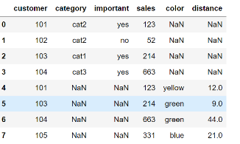
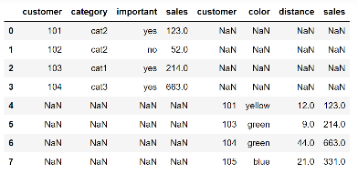
Pandas Functions
Pandas functions: groupby, value_counts, describe(), info(), shape(), size(), isnull.sum(), unique/nunique, pd.to_datetime, pd.Timedelta, pd.concat, pd.merge, df1.join(df2, how=?, on=?)
 | customer | category | important | sales
0 | 101 | cat2 | yes | 123
1 | 102 | cat2 | no | 52
2 | 103 | cat1 | yes | 214
3 | 104 | cat3 | yes | 663
 | customer | color | distance | sales
4 | 101 | yellow | 12 | 123
5 | 103 | green | 9 | 214
6 | 104 | green | 44 | 663
7 | 105 | blue | 21 | 331
Concatenate
axis=0 (rows)
axis=1 (columns)

Slide 21
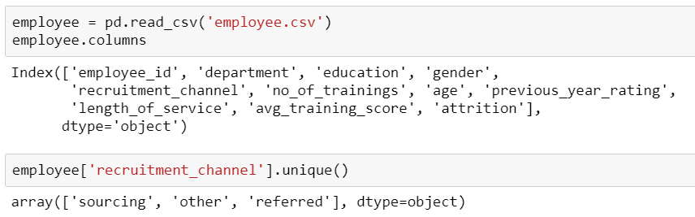
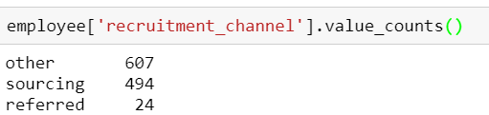
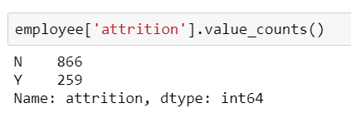
Typical use cases for unique & valuecount
Mainly used in understanding proportions of levels of a categorical variable
value_count – proportion of employees recruited from each recruitment source
unique - What are the sources of recruitment in the dataset
value_count – proportion of attrition in a dataset

Slide 22
Typical use cases of a python dictionary
Use whenever a mapping from a key to a value is required
mapping a field Unique ID to their human-friendly labels
dictionary of genres in a movie database
Sentiment analysis
{'id': 28, 'name': 'Action'}, {'id': 35, 'name': 'Comedy'}, {'id': 10402, 'name': 'Music'}, {'id': 10751, 'name': 'Family'}, {'id': 12, 'name': 'Adventure’}
based on dictionary of positive & negative words

Slide 23
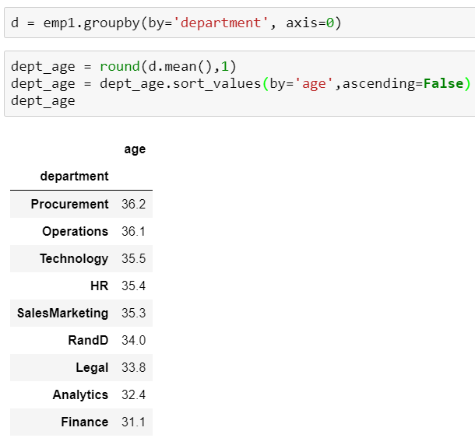
Application of group by
Similar to pivot tables in excel
What is the average age of employees in each department in the employee dataset?
What is the highest rating a movie has received in the genre “comedy”?

Slide 24
Merge vs Join
Merge – merges 2 df using a unique column identifier (primary key)
Join – to join 2 dataframes by the index

Slide 25
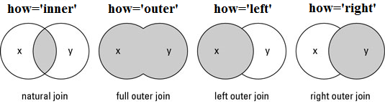
Types of merge
Natural join - Intersection
Full outer join - Union
Left outer join
Right outer join
To keep only rows that match from the data frames, specify the argument how=‘inner’.
To keep all rows from both data frames, specify how=‘outer’.
To include all the rows of your data frame x and only those from y that match, specify how=‘left’.
To include all the rows of your data frame y and only those from x that match, specify how=‘right’.

Slide 26
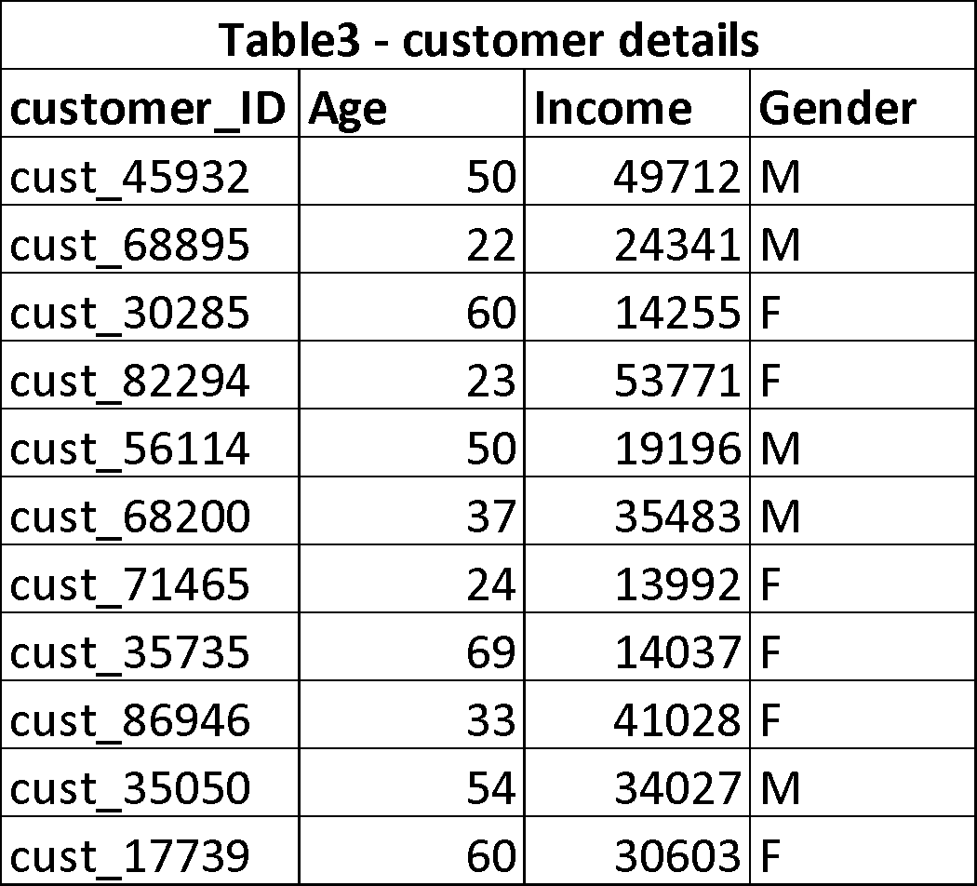
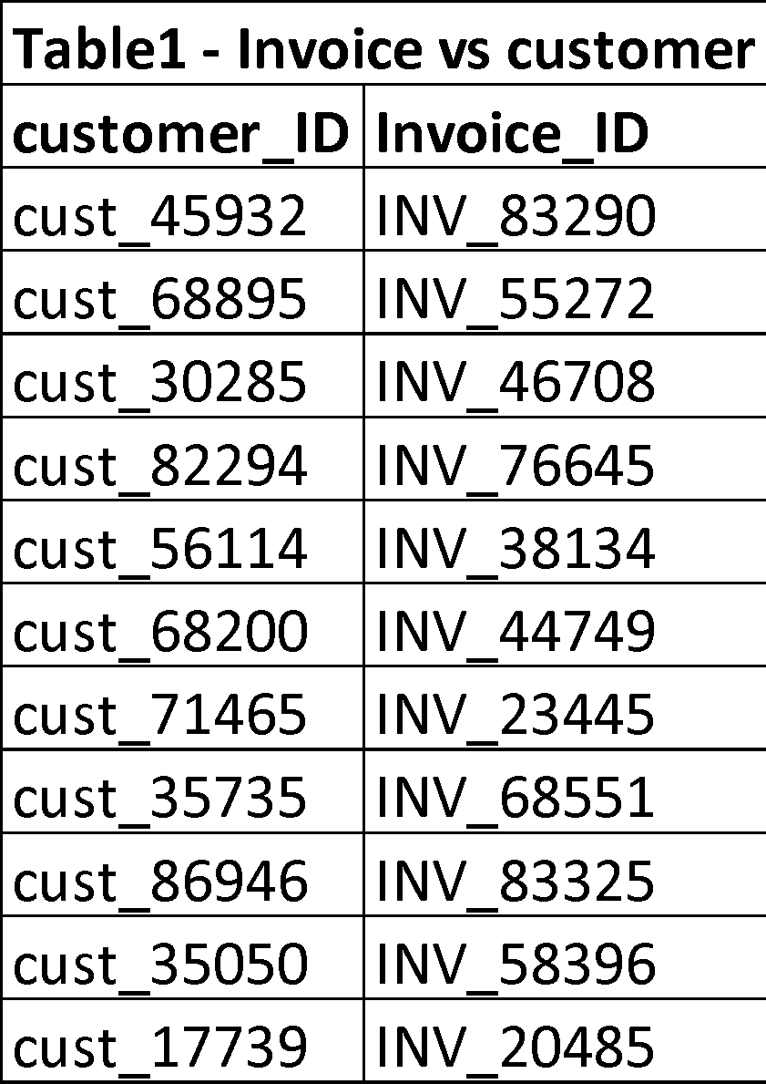
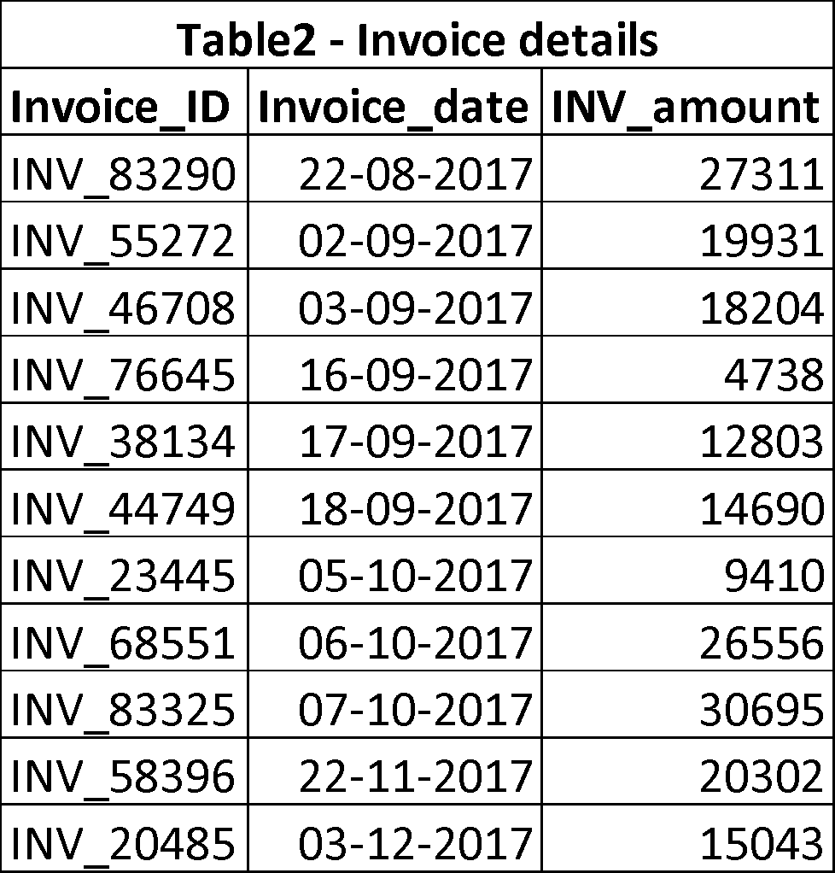
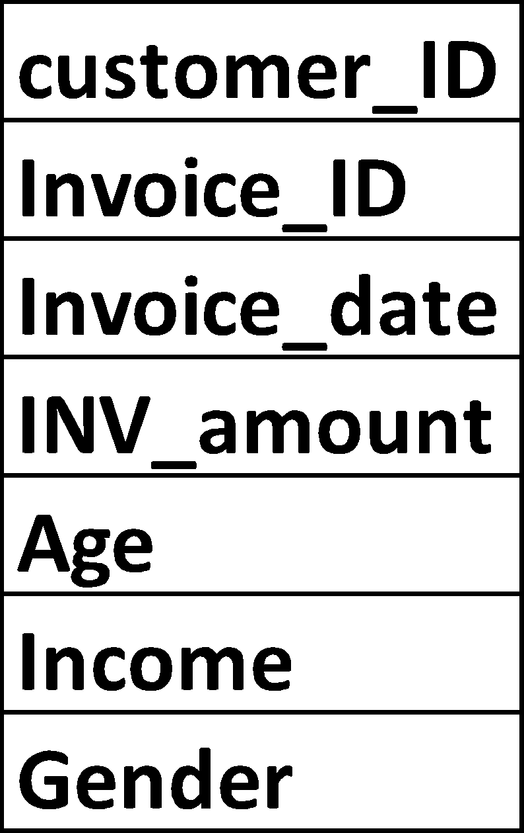
Uses of Merge & Join
Create a transactional dataframe per customer to analyse purchasing patterns according to customer demography

Slide 27
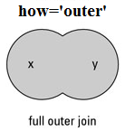
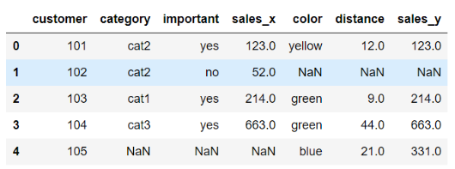
Pandas Functions
Pandas functions: groupby, value_counts, describe(), info(), shape(), size(), isnull.sum(), unique/nunique, pd.to_datetime, pd.Timedelta, pd.concat, pd.merge, df1.join(df2, how=?, on=?)
 | customer | category | important | sales
0 | 101 | cat2 | yes | 123
1 | 102 | cat2 | no | 52
2 | 103 | cat1 | yes | 214
3 | 104 | cat3 | yes | 663
 | customer | color | distance | sales
4 | 101 | yellow | 12 | 123
5 | 103 | green | 9 | 214
6 | 104 | green | 44 | 663
7 | 105 | blue | 21 | 331
Merge (how=“outer”)
on=‘customer’
To keep all rows from both data frames, specify how=‘outer’

Slide 28
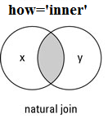
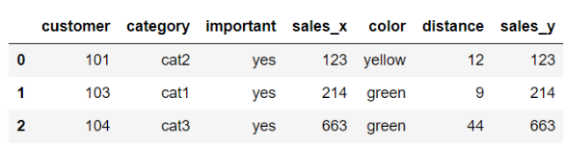
Pandas Functions
Pandas functions: groupby, value_counts, describe(), info(), shape(), size(), isnull.sum(), unique/nunique, pd.to_datetime, pd.Timedelta, pd.concat, pd.merge, df1.join(df2, how=?, on=?)
 | customer | category | important | sales
0 | 101 | cat2 | yes | 123
1 | 102 | cat2 | no | 52
2 | 103 | cat1 | yes | 214
3 | 104 | cat3 | yes | 663
 | customer | color | distance | sales
4 | 101 | yellow | 12 | 123
5 | 103 | green | 9 | 214
6 | 104 | green | 44 | 663
7 | 105 | blue | 21 | 331
Merge (how=“inner”)
on=‘customer’
To keep only rows that match from the data frames, specify the argument how=‘inner’.

Slide 29
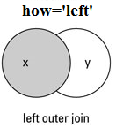
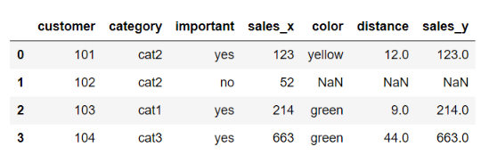
Pandas Functions
Pandas functions: groupby, value_counts, describe(), info(), shape(), size(), isnull.sum(), unique/nunique, pd.to_datetime, pd.Timedelta, pd.concat, pd.merge, df1.join(df2, how=?, on=?)
 | customer | category | important | sales
0 | 101 | cat2 | yes | 123
1 | 102 | cat2 | no | 52
2 | 103 | cat1 | yes | 214
3 | 104 | cat3 | yes | 663
 | customer | color | distance | sales
4 | 101 | yellow | 12 | 123
5 | 103 | green | 9 | 214
6 | 104 | green | 44 | 663
7 | 105 | blue | 21 | 331
Merge (how=“left”)
on=‘customer’
To include all the rows of your data frame x and only those from y that match, specify how=‘left’.

Slide 30
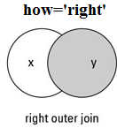
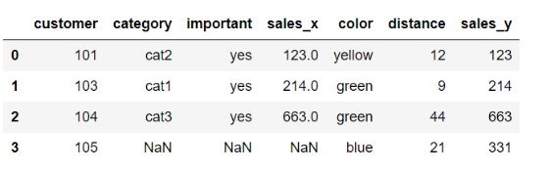
Pandas Functions
Pandas functions: groupby, value_counts, describe(), info(), shape(), size(), isnull.sum(), unique/nunique, pd.to_datetime, pd.Timedelta, pd.concat, pd.merge, df1.join(df2, how=?, on=?)
 | customer | category | important | sales
0 | 101 | cat2 | yes | 123
1 | 102 | cat2 | no | 52
2 | 103 | cat1 | yes | 214
3 | 104 | cat3 | yes | 663
 | customer | color | distance | sales
4 | 101 | yellow | 12 | 123
5 | 103 | green | 9 | 214
6 | 104 | green | 44 | 663
7 | 105 | blue | 21 | 331
Merge (how=“right”)
on=‘customer’
To include all the rows of your data frame x and only those from y that match, specify how=‘right’.

Slide 31
Case Study 1
Uber Drive Data Analysis -
The data of a driver’s uber trips are available for year 2016.
Your manager wants you to explore this data to give him some useful insights about the trip behaviour of a Uber driver.
Dataset -
The dataset contains Start Date, End Date, Start Location, End Location, Miles Driven and Purpose of drive (Business, Personal, Meals, Errands, Meetings, Customer Support etc.)

Slide 32
Steps
1. Import the libraries 2.Get the data and observe it 3.Check missing values, either remove it or fill it. 4.Get summary of data using python function. 5.Explore the data parameter wise Here we have information of destination(start and stop), time(start and stop), category and purpose of trip, miles covered.

Slide 33
Case Study 2
Weekly Schedule Tracker Data Analysis -
The data from a schedule tracker app of a professional working from home is available for the 3rd week of April 2021.
You want to analyze this data to get insights on how this professional is using his time and provide him/her a report to help him decide future opportunities to improve his/her scheduling
Dataset -
The dataset contains records of activities with Start Time, End Time, Category and Activity for the mentioned week.

Slide 34
Steps
1. Import the libraries 2.Get the data and observe it. (“Weekly_schedule_tracker.csv”) 3.Check missing values, either remove it or fill it. 4.Get summary of data using python function. 5.Explore the data parameter wise Here we have information of time(start and stop), category and activity details. Use of data and time functions is recommended.

Slide 35
Case Study 3: Online Games
Data has various online boardgames and metadata associated with it to analyze
There's game attributes and user feedback as part of the dataset
Import libraries, data and study the key aspects of these online boardgames.

Slide 36


Questions?

